Slide 1
FY26 Budget Finalization Meeting

Slide 2
Agenda
Action Items (add items as needed)
Approval of Agenda
Approval of Previous Minutes
Final Budget Recommendation (after final presentation/review and discussion)
Discussion Items (add items as needed)
Presentation of the final budget recommendation
i. ACTION ITEM: GO Team vote on Budget (AFTER presentation and discussion)
Information Items (add items as needed)
Principal’s Report
i. CCRPI scores
CAT Report: February 24, 2025 Meeting
Committee Reports (as needed)
Announcements
Public Comment (if applicable)

Slide 3
Norms
This is a meeting of the GO Team. Only members of the team may participate in the discussion. Any members of the public present are here to quietly observe.
We will follow the agenda as noticed to the public and stay on task.
We invite and welcome contributions of every member and listen to each other.
We will respect all ideas and assume good intentions.

Slide 4
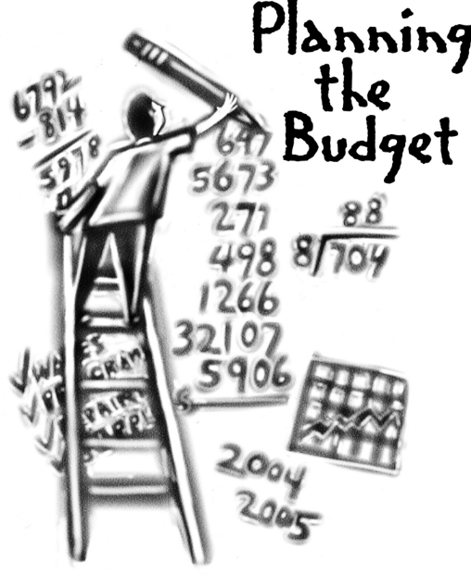
Overview of FY 26
GO Team Budget Process
Step 2 Principals Workshop FY 26 Budget
January 15
Step 4 Principals Cluster Supt. Discussions
Step 1 Update Strategic Plan & Rank Priorities
Step 7 Principals HR Staffing Conferences Begin
Feb. 24-27
Step 3 GO Team Initial Budget Session
January 15-31
Step 8* GO Team Budget Finalization Meeting
Budgets Approved by March 14
Step 6 Cluster Supt. Review February 17-21
Step 5* GO Team Feedback Mtg. February 10-14
GO Teams are encouraged to have ongoing conversations
* GO Teams will need to take ACTION on the budget at these meetings.

Slide 5
Budget Finalization Meeting
What
During this meeting GO Teams will review all components of the budget, which should be updated based on feedback from the Cluster Superintendent and key leaders. After review, GO Teams will take action (i.e., vote) on the FY26 Budget.
Why
Principals will present the final budget recommendations for GO Team approval.
When
All approval meetings must be held after staffing conferences. Budgets must be approved by March 14th.

Slide 6
Budget Updates

Slide 7
Changes since Feedback Meeting
There were changes made to the draft budget we discussed at our last meeting.
These changes reflect an allocation change of + $220, 000.
Changes are detailed on the next slide.

Slide 8
Summary of Changes since Feedback Meeting
Allocation/Staffing Change | Change from Feedback Presentation
Budget team found an additional money in General Budget | I had to move the items from the signature funds budget sheet to the non-staffing sheet. While it is not a staffing change, our TOK teacher is now listed as a Signature Funds teacher instead of a Social Studies teacher.
Added the Arabic Teacher back to the budget | I had to decrease the amount on computer equipment by $11, 491, decrease administrative travel by $15,000, and secretary overtime by $5, 000 to make sure that all the signature funds items could be accounted for in the non-staffing sheet.

Slide 9
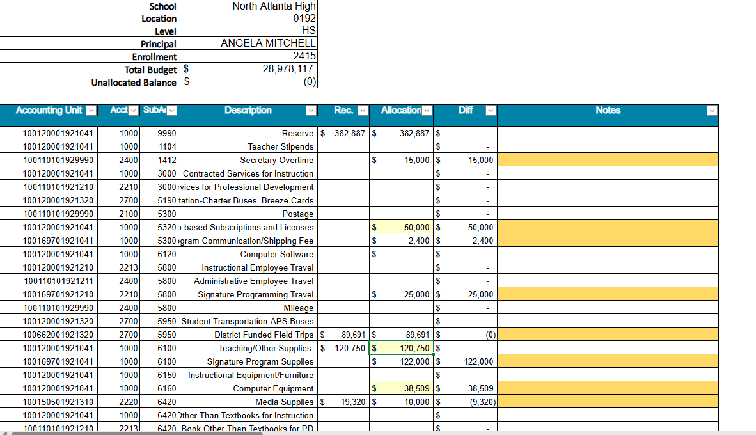

Slide 10
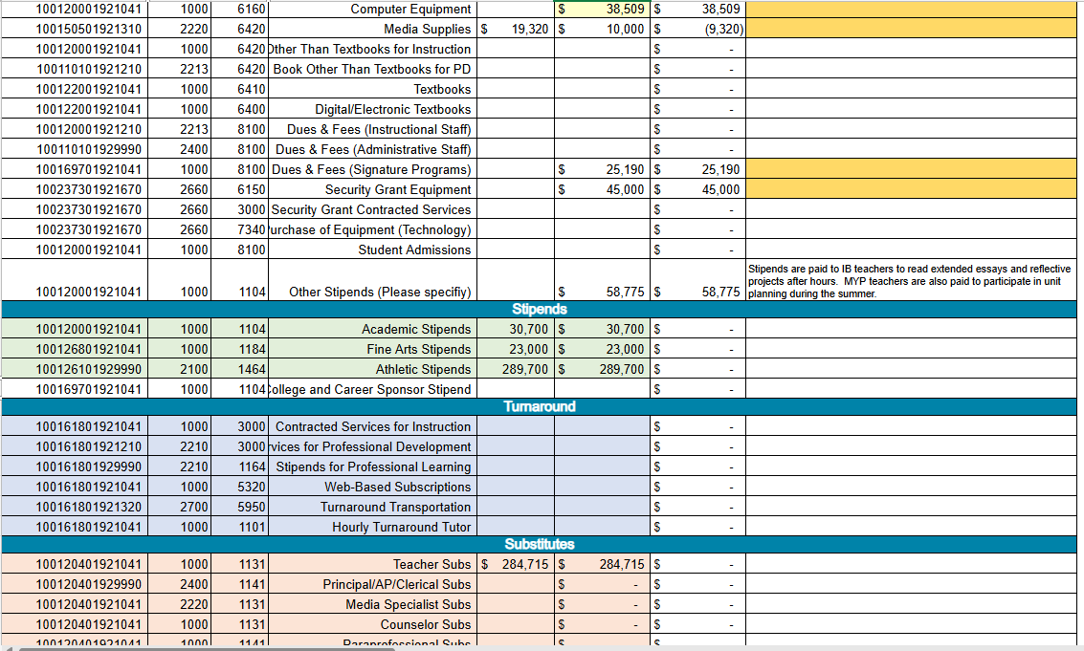

Slide 11
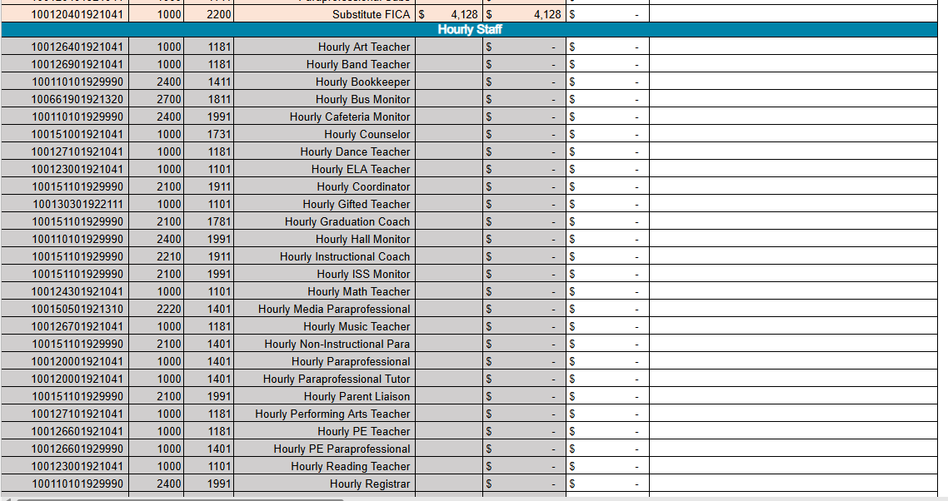

Slide 12
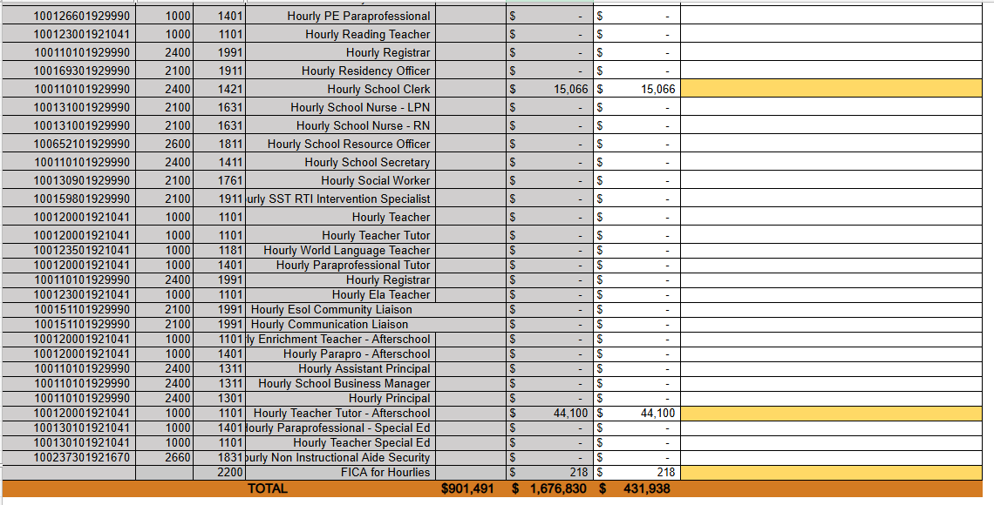

Slide 13
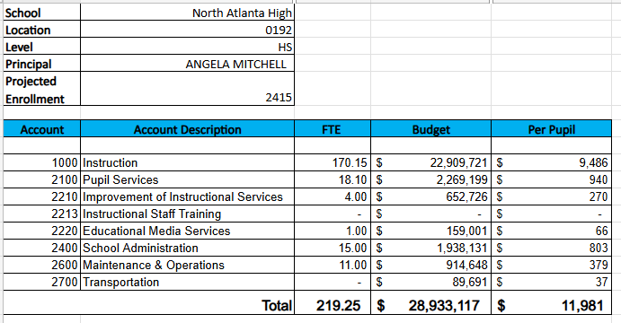
Budget by Function (required)
*Based on Current Allocation of School Budget

Slide 14
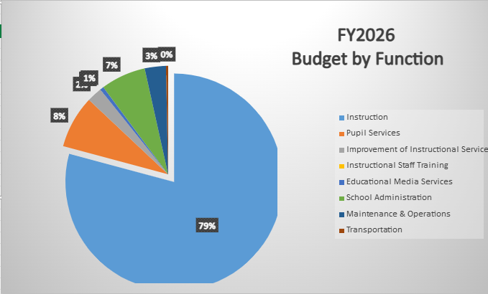
Budget by Function (required)
*Based on Current Allocation of School Budget

Slide 15
Discussion & Questions

Slide 16
Action on the Budget
The GO Team needs to TAKE ACTION (vote) on its FY26 budget.
After the motion and a second, the GO Team may have additional discussion.
Once discussion is concluded, the GO Team will vote.

Slide 17
Additional Agenda Items
Information Items (add items as needed)
Principal’s Report
CCRPI Score
CAT Report: February 24, 2025 Meeting
Committee Reports (as needed)
Announcements
Public Comment (if applicable)

Slide 18
CCRPI Score – 88.2
https://ccrpi.gadoe.org/Reports/Views/Shared/_Layout.html

Slide 19
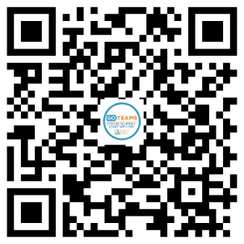
EXTENDED - declare by March 7!
tinyAPS.com/?2025GOTeamDeclaration

Slide 20
Thank you!

Slide 21
Appendix
FY26 Feedback Presentation

Slide 22
Principals
To ensure transparency, consistency, and clarity for stakeholders, please COPY your Budget Feedback Presentation into this appendix using one of the following methods:
Option 1
Copy Your Budget Feedback Presentation into This Template
Open your Budget Feedback presentation in PowerPoint.
Click on the first slide in the left panel of the Feedback Presentation.
Select all the Feedback Presentation slides (Ctrl+A/Cmd+A to select all slides).
Right-click and choose Copy.
Click after this slide (you’ll see a red bar in the left pane)
Right-click and select Paste. Choose Keep Source Formatting to maintain formatting.
Option 2
Add These Slides to the Front of your Budget Feedback Presentation
Open your Budget Feedback presentation in PowerPoint and Save a Copy (File/Save a Copy). This will become your Finalization Presentation.
Click on the first slide in the left panel of this presentation.
Select all the Finalization Presentation slides (Ctrl+A/Cmd+A to select all slides).
Right-click and choose Copy.
Open the Copy of your Feedback Presentation and Click before the first slide (you’ll see a red bar in the left pane)
Right-click and select Paste. Choose Keep Source Formatting to maintain formatting.

Slide 23
FY26 Budget Feedback Meeting

Slide 24
AGENDA
Action Items (add items as needed)
Approval of Agenda
Approval of Previous Minutes
Discussion Items (add items as needed)
Budget Development Presentation
ACTION ITEM: GO Team vote on Draft Budget (AFTER presentation and discussion)
Information Items (add items as needed)
Principal’s Report
Update on DLI
Scheduling updates for next year
Winter Break Learning Opportunities
Committee Reports (as needed)
Cluster Advisory Report (if CAT has met since last meeting)
Announcements (add items as needed)
Public Comment (if applicable)

Slide 25
Meeting Norms
This is a meeting of the GO Team. Only members of the team may participate in the discussion. Any members of the public present are here to quietly observe.
We will follow the agenda as noticed to the public and stay on task.
We invite and welcome contributions of every member and listen to each other.
We will respect all ideas and assume good intentions.

Slide 26
Budget Feedback presentation & Discussion

Slide 27
GO Team Budget Development Process
YOUR SCHOOL STRATEGIC PLAN…
is your roadmap and your role.
It is your direction, your priorities, your vision, your present, your future.
Step 1: Data Review
Step 2: Strategic Plan Review
Step 3: Budget Parameters
(Strategic Priorities)
Step 4: Budget Choices

Slide 28
Overview of FY26 GO Team Budget Process
Step 2 Principals Workshop FY 26 Budget
January 15
Step 4 Principals Cluster Supt. Discussions
Step 1 Update Strategic Plan & Rank Priorities
Step 7 Principals HR Staffing Conferences Begin
Feb. 24-27
Step 3 GO Team Initial Budget Session
January 15-31
Step 8* GO Team Final Budget Approval Meeting
Budgets Approved by March 14
Step 6 Cluster Supt. Review February 17-21
Step 5* GO Team Feedback Mtg. February 10-14
GO Teams are encouraged to have ongoing conversations
* GO Teams will need to take ACTION on the budget at these meetings.

Slide 29
Budget Feedback Meeting
What
During the GO Team Feedback meeting the principal will share the 25-26 Strategic Plan Breakout, provide an overview of the school’s draft budget, share updated tabs from the Excel template, and review/collaborate with the GO Team on the comments/notes to explain the use of school-level flexibility in budget allocations.
Why
This meeting provides an opportunity for GO Teams to discuss the principal’s proposed budget and how it supports the school's programmatic needs and key strategic priorities for the 25-26 school year. It also provides the GO Team the opportunity to review and provide feedback on proposed use of school-level flexibility.
When
Early February 10 - February 14th, before Cluster Superintendent review.

Slide 30
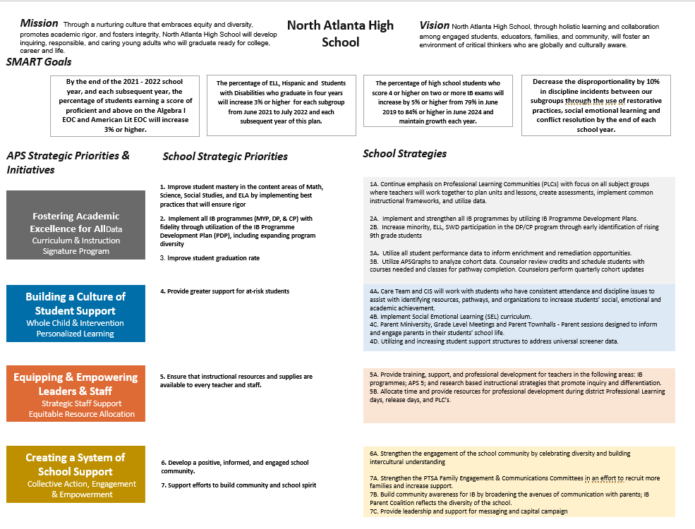
NORTH ATLANTA Strategic Plan

Slide 31
North Atlanta
Strategic Plan
Priority Ranking
Insert the school’s ranked priorities from High to Low
Higher
Ensure that instructional resources and supplies are accessible to all staff.
2. Enhance student achievement in core content areas (math, science, social studies, and ELA).
3. Provide increased support to students at risk.
4. Raise the student graduation rate.
5. Implement the IB programmes (MYP, DP, and CP) with fidelity through the IB Programme Development Plan (PDP), including expanding program diversity.
6. Develop a positive, informed school community.
Lower

Slide 32
FY 26 Budget Parameters
FY26 Ranked School Priorities | Rationale
Ensure that instructional resources and supplies are accessible to all staff. | Providing equitable access to instructional resources and supplies empowers all staff to deliver high-quality education, fosters consistency in teaching, and promotes a collaborative environment where everyone can effectively meet the needs of students.
Enhance student achievement in core content areas | Enhancing student achievement in core content areas is essential to equip students with the foundational knowledge and skills needed for academic success, critical thinking, and future career opportunities. Strengthening these areas ensures students are prepared to meet educational standards and excel in a competitive, global economy.
Provide increased support to students at risk. | Providing increased support to students at risk is essential to ensure equitable opportunities for academic and personal success. Targeted interventions address their unique challenges, helping to close achievement gaps, improve engagement, and promote long-term well-being and future potential.

Slide 33
FY 26 Budget Parameters
FY26 School Priorities | Rationale
Raise the student graduation rate. | Increasing the graduation rate is vital for fostering individual success and community growth. Higher graduation rates open pathways to better career opportunities, reduce socioeconomic disparities, and contribute to a more skilled and productive workforce, ultimately strengthening the economy and society.
Implement IB programs with fidelity | This will improve learning outcomes for all learners who participate in the programs and ensure that students are ready for the rigors of college.
Develop a positive, informed school community. | A positive, informed school community fosters trust, collaboration, and a sense of belonging among students, staff, and families. It enhances student success, encourages parental involvement, supports teacher morale, and creates a safe, inclusive environment. By keeping everyone informed and engaged, the community can work together effectively to address challenges, celebrate achievements, and build a strong foundation for lifelong learning and growth.

Slide 34
Review of FY26 Signature and Turnaround Program Funding Process
Overview
* The district is piloting a zero-based budgeting (ZBB) process for Signature and Turnaround Program Funds this year.
* Zero-based budgeting (ZBB) is a budgeting process that allocates funding based on program efficiency and necessity rather than budget history. As opposed to traditional budgeting, no item is automatically included in the next budget.
* As such the initial allocation for these programs at all schools will be $0.
Process
* Principals will develop proposed requests for the personnel and non-personnel they need to support the Signature and/or Turnaround Programs at their schools.
* Principals will share and discuss their proposals and rationale for the proposals with their school GO Team for feedback.
* After discussing with their GO Team, principals will submit their request for review by January 31st. Funding for these programs will be provided the week of February 3rd.

Slide 35
Overview of Approved Signature Program Funds

Slide 36
Signature program funds requested vs. approved
Requested Signature Program Funds: $548, 353
PRINCIPALS: Please update with the list of what you requested to support your signature program. Example: Signature Program Coaches - 2 Signature Programming Supplies/Resources - $234, 490.00
APPROVED Signature Program Funds: $548, 353
PRINCIPALS: Please update with the Staffing and Non-Staffing allocation of your updated Signature Program funds. Signature Program Coaches - 2 Signature Programming Supplies/Resources - $234, 490.00

Slide 37
North Atlanta HiGh school FY26 Summary of Proposed Staffing AND Non-Staffing
-

Slide 38
Summary Tab Overview
The Summary Tab provides a summary of the staff in our school. The columns show how many positions are:
Earned – positions allocated by district departments. There is no school-level flexibility with these positions.
Funded – District’s recommended staffing for positions where there is school-level flexibility with staffing the position.
Staffed – This shows how the principal plans to staff the position for the FY26 school year.
Difference—This shows the difference between the recommendation from the District and the Principal's proposed FY26 staffing plan.
Comments: The principal must provide comments if there is a difference in what is Funded and Staffed. Principals and GO Teams will discuss the rationale provided for the Comments section.
Position Title | Earned | Funded | Staffed | Dif | Comments
Teachers
Middle School Core |  | 49.50 | - | (49.50)
Middle Electives |  | 19.00 | - | (19.00)
Teacher Math 6-8 |  |  | 11.00 | 11.00
Teacher Science 6-8 |  |  | 10.00 | 10.00
Teacher Social Studies 6-8 |  |  | 10.00 | 10.00
Teacher ELA 6-8 |  |  | 9.00 | 9.00
Teacher Art 6-8 |  |  | 2.00 | 2.00
Teacher Band 6-8 |  |  | 1.00 | 1.00
Teacher Music 6-8 |  |  | 2.00 | 2.00
Teacher Orchestra 6-8 |  |  | 1.00 | 1.00
Teacher Physical Ed 6-8 |  |  | 7.00 | 7.00
Teacher Performing Arts 6-8 |  |  | 2.00 | 2.00
Teacher World Language 6-8 |  |  | 12.00 | 12.00
Teacher Gifted |  | 13.00 | 11.00 | (2.00)
Teacher Social Emotional Learning |  |  | - | -
EIP TEACHERS |  | 3.50 | 5.00 | 1.50
Teacher REP 6-12 |  |  | 5.00 | 5.00

Slide 39
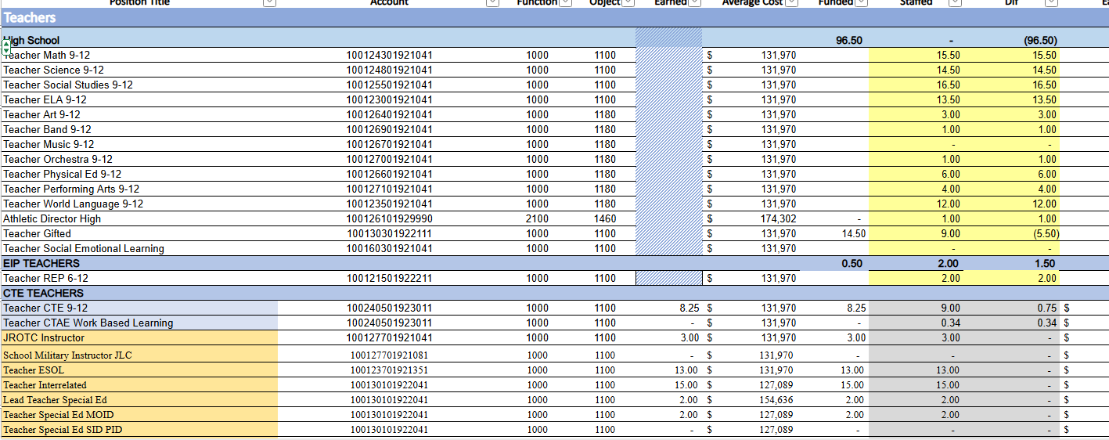

Slide 40
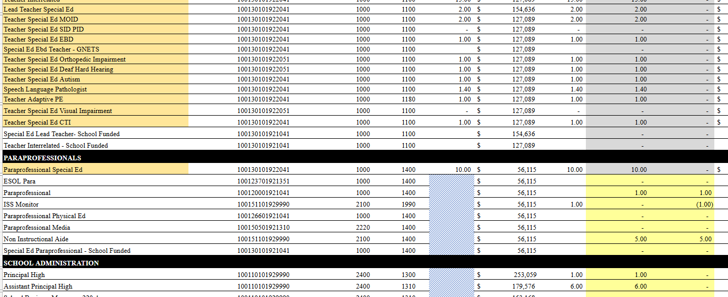

Slide 41
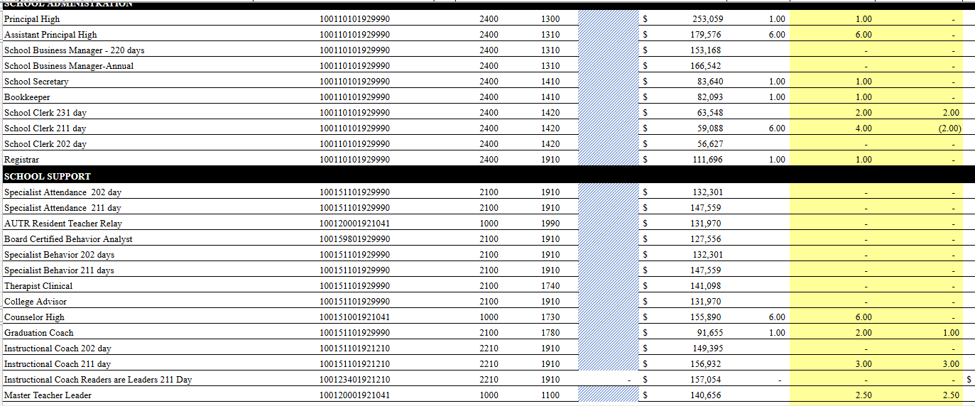

Slide 42
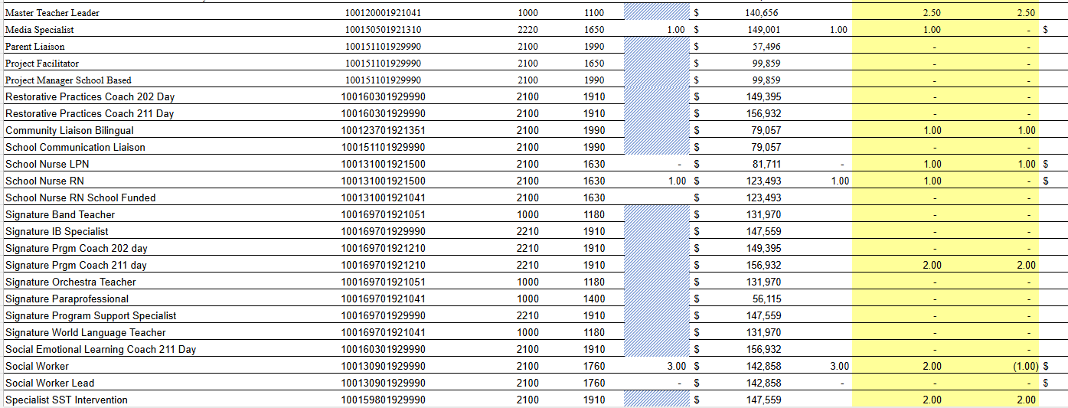

Slide 43
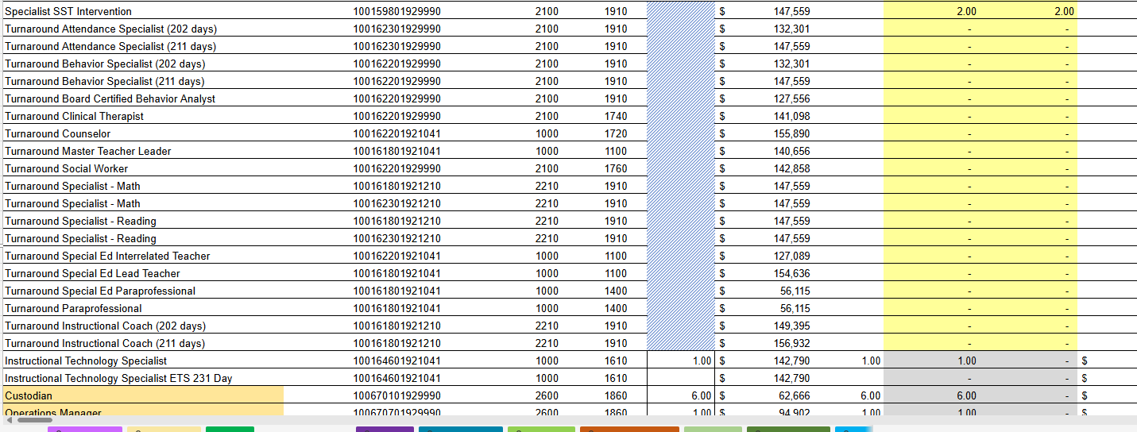

Slide 44
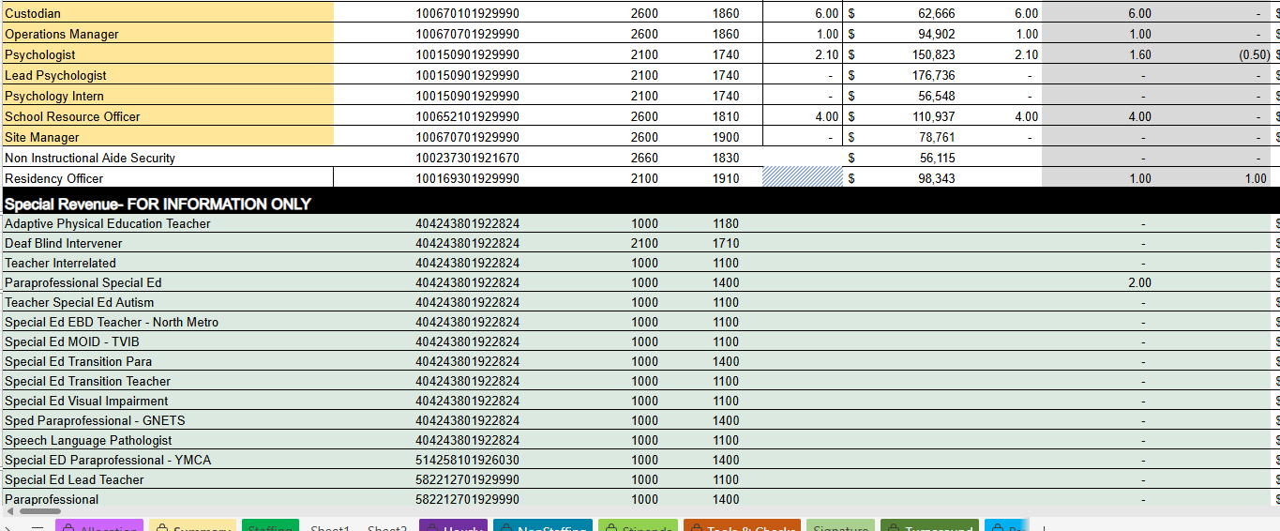

Slide 46
Summary of position Changes to Support the fy26 bUDGET
CREATED | REMOVED
Counselor | I will have this updated for our actual meeting on Thursday. I don’t want to share this information until the staff impacted is notified.
 | 7 positions
Summary of Changes
PRINCIPALS: Please provide a summary of the impact these changes and how it relates to your strategic plan here.

Slide 47
Non-Staffing Tab Overview
The Non-Staffing Tab shows how funds are allocated for non-staff items in the school. There is school-level flexibility for most of these items. The tab has columns for:
Recommended—District’s recommended amount to spend on the line item.
Allocation – This shows how much the principal is proposing to allocate towards the line item in FY26.
Difference—This shows the difference between the recommended amount and the allocation.
Notes: The principal must provide comments if there is a difference in what is Recommended and what is Allocated. Principals and GO Teams will discuss the rationale for the notes section.
Description | Rec. | Allocation | Diff | Notes
Reserve | $ 291,149 | $ 291,149 | $ -
Teacher Stipends |  |  | $ -
Secretary Overtime |  |  | $ -
Contracted Services for Instruction |  |  | $ -
Contracted Services for Professional Development |  |  | $ -
Web-based Subscriptions and Licenses |  |  | $ -
Signature Program Communication/Shipping Fee |  |  | $ -
Computer Software |  | $ - | $ -
Mileage |  |  | $ -
Student Transportation-APS Buses |  |  | $ -
District Funded Field Trips | $ 60,886 | $ 60,886 | $ -
Teaching/Other Supplies | $ 81,900 |  | $ (81,900)
Signature Program Supplies |  |  | $ -
Computer Equipment |  |  | $ -
Media Supplies | $ 13,104 |  | $ (13,104)
Example

Slide 48
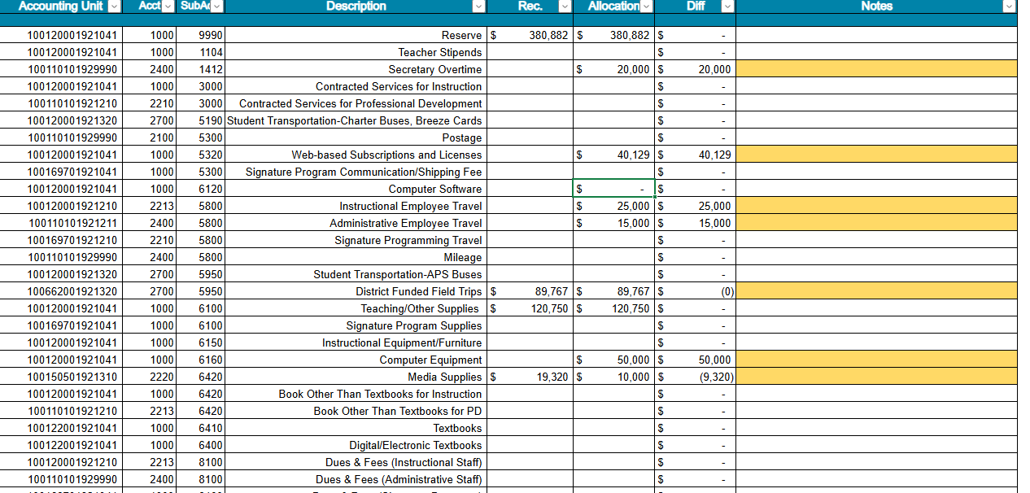

Slide 49
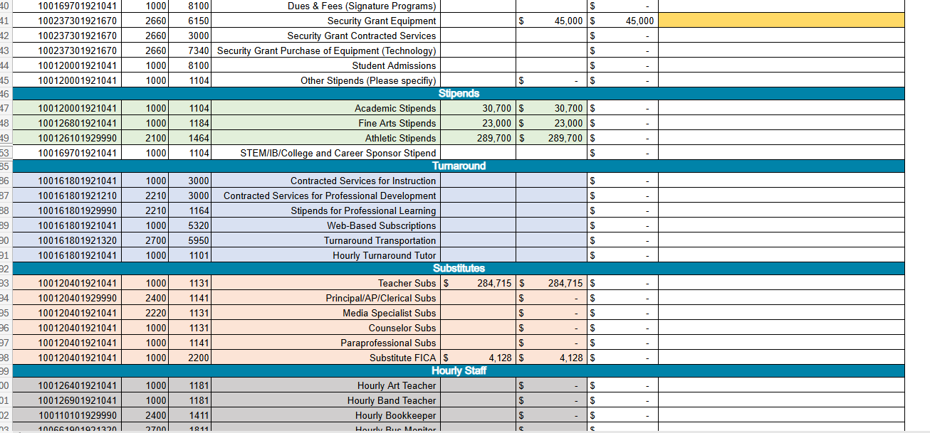

Slide 50
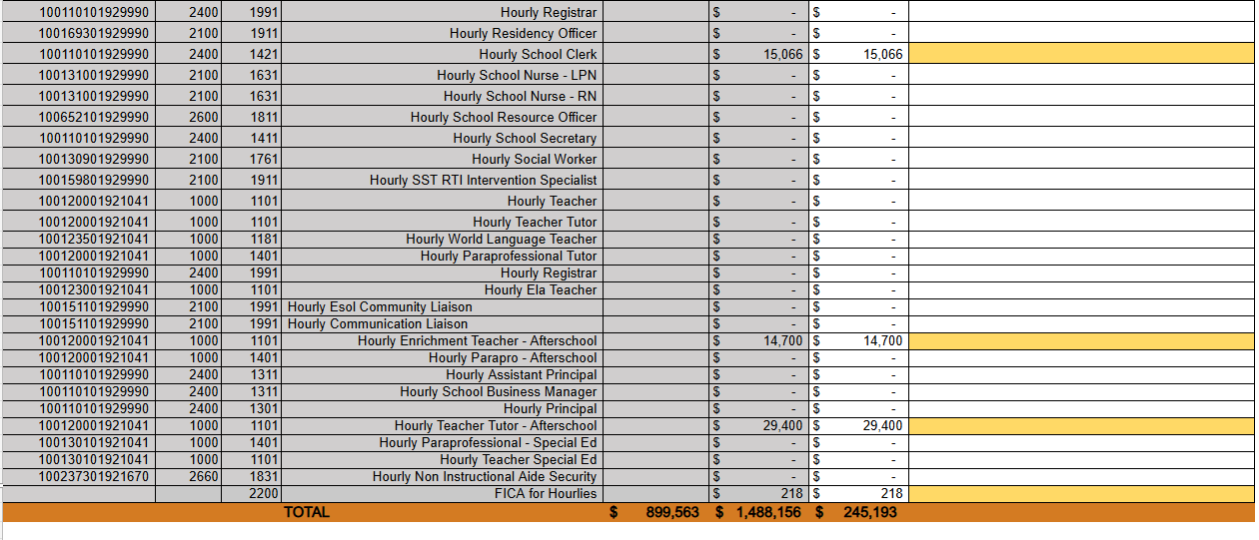

Slide 51
Descriptions of Strategic Plan Breakout Categories
Priorities: FY25 funding priorities from the school’s strategic plan, ranked by the order of importance.
Strategies: Lays out specific objectives for school’s improvement.
Request: “The Ask” What needs to be funded in order to support the strategy?
Amount: What is the cost associated with the Request?

Slide 52
FY26 Strategic Plan Break-out
Priorities | Strategies | Requests | Amount
Ensure that instructional resources and supplies are accessible to all staff. | Increase the amount allotted for supplies. | School district suggested $120,750 Requested $122,000 for IB Supplies and Resources | $242, 750
Enhance student achievement in core content areas | Plan for programs such as Power UP and Project Hope so that students can receive additional support and recovery in real time. |  | $44, 1000 Teachers’ salaries
Provide increased support to students at risk.
Raise the student graduation rate. | Increase number of audits through the 4 years. Teach students to audit their own transcripts. | Add an additional counselor. | $155, 890.00
Implement IB programs with fidelity |  |  | $548, 353

Slide 53
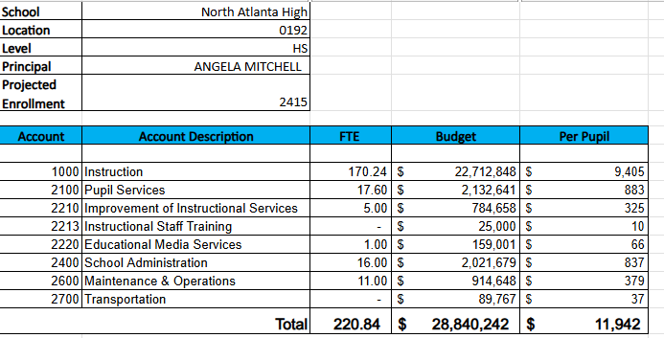
FY26 Budget by Function (required)
* Based on Current Allocation of School Budget

Slide 54
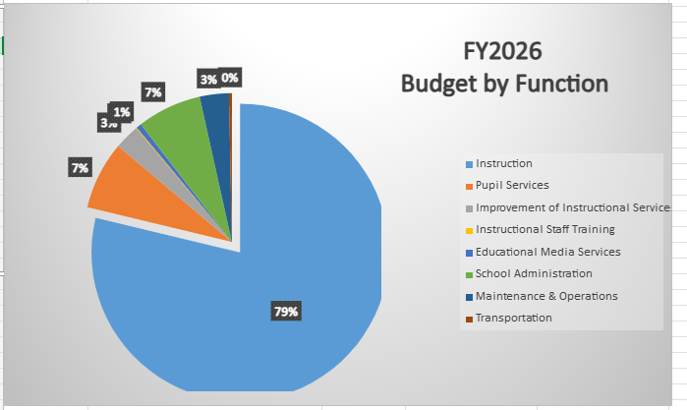
FY26 Budget by Function (required)
* Based on Current Allocation of School Budget

Slide 55
Questions for the GO Team to Consider and Discuss
Strategic Alignment and School-Level Flexibility
Does this budget proposal, as a whole, effectively support our school's strategic priorities?
How do the principal’s proposed changes directly support priorities in our strategic plan? Can we clearly connect each adjustment to a strategic goal?
If new positions, resources, or programs are being added, what data or feedback supports these changes? How will we measure their impact?
What trade-offs are involved? Are any current programs or resources being adjusted or reduced, and how will that affect our students and staff?

Slide 56
Questions for the GO Team to Consider and Discuss
District and Cluster Priorities
How do these proposed changes align with district and cluster priorities? Do we foresee any challenges or misalignments?
If the district has allocated funds for specific initiatives – for example Signature Programs - how are those reflected in our budget?
If we are sharing staff positions (e.g., nurse, counselor, teacher), how will this affect student support and service delivery at our school?

Slide 57
Discussion of Reserve & Holdback Funds

Slide 58
Plan for FY26 Leveling Reserve
$380,882.00
Priorities | Strategies | Requests | Amount
Improve student mastery in the content areas of Math, Science, Social Studies, and ELA by implementing best practices that will ensure rigor. | Create an incentive program for students who improve attendance, behavior, and grades during the school year. This initiative will be geared toward subgroups – ELL, SWD, Hispanic – but not exclusive to them. | Money for incentives | $20 K
Improve student mastery in the content areas of Math, Science, Social Studies, and ELA by implementing best practices that will ensure rigor. | Increase the number of minority students who participate in the IB program. | Money for teacher mentors Money for resources for IB buddies | $50 K

Slide 59
Plan for FY26 Leveling Reserve
$380,882.00
Priorities | Strategies | Requests | Amount
Provide greater support for at-risk students. |  | Add additional SELT | $154,636.00
Provide greater support for at-risk students. | Create and implement a recovery program during the second half of 1st semester to reduce the number of first semester failures. This money includes busses. |  | $75 K
Provide greater support for at-risk students. | Create and after-school tutorial program so teachers are paid to tutor students who need assistance beyond the weekly tutorial held by teachers. |  | $75 K
Provide greater support for at-risk students. | Purchase Chromebooks so that teachers have computers for students to use in class. |  | $66, 186 K

Slide 60
Where We’re Going
Our next meeting is the Budget Approval Meeting
What:
During this meeting we will review the budget, which should be updated based on feedback from the staffing conference, Associate Superintendents, and key leaders. After review, GO Teams will need to take action (i.e., vote) on the FY25 Budget.
Why:
Principals will present the final budget recommendations for GO Team approval.
When:
All approval meetings must be held after staffing conferences. Budgets must be approved by March 15th.

Slide 61
What’s Next?
February
Cluster Superintendent Review (February 17-21)
HR Staffing Conferences (February 24– February 27)
March
Final GO Team Approval Meeting (AFTER your school’s Staffing Conference and BEFORE Friday, March 14th)
ACTION (i.e.- GO Team votes) on final budget recommendation before March 14

Slide 62
Thank you!

Slide 63
Will be updated As soon as possible

